Slide 1

Nowcasting of Satellite Images Using AI/ML Techniques
Category : SOFTWARE
Domain : Miscellaneous
PS ID : NM374
Team Name : Apollo6

Slide 2
Team Members
Mentors
Niraj Chaudhari
Shubham Gurav
Bhushan Bamble
Prasanna Rajendra
Shubham Belgaonkar
Ojaswi Deshmukh
Dr.Amit Barve
Mr.Manmeet Singh

Slide 3
Table of contents
1
Introduction
7
Training and Data details
Literature Review
8
Jury suggestions Day1
2
Time Series Sequence Forecast
9
Jury suggestions Day2
3
Sequence to Sequence Learning
10
Jury suggestions Final Day Mentoring
4
Composite model
11
Future Work
5
12
References
6
Encoding forecasting structure

Slide 4
Introduction
1
Nowcasting is a technique for very short-range forecasting that maps the current weather, then uses the direction of movement to forecast the weather a short period ahead.
The goal of nowcasting is to use the previously observed sequence to forecast a fixed length of the future frames in a local region over a relatively short period of time.
Nowcasting of meteorological images will help in forecasting images for next 3 hrs.
As per our Problem Statement, we’ll be developing an AI/ML based software to generate nowcasted satellite images and its animation loop for next 3 Hrs. at an interval of 30 Min. using data from INSAT-3D and INSAT-3DR
2
3
4

Slide 5
Literature Review
1
Prediction of Satellite Image Sequence for Weather Nowcasting Using Cluster-Based Spatiotemporal Regression [1]
For Nowcasting of satellite image, Shukla et al developed Fuzzy Clustering technique using Cluster-Based Spatiotemporal Regression
TIR channel data of Kalpana-1 satellite of Image size 100 x 100 has been used
2
Unsupervised Learning of Video Representations using LSTMs [2]
To predict Video frames, Srivastava et al , built a LSTM encoder-decoder-predictor model which reconstructs the input sequence and predicts the future sequence simultaneously
Images of size 224 × 224 has been used for training the model
3
Convcast: An embedded convolutional LSTM based architecture for precipitation nowcasting using satellite data [3]
For Precipitation Nowcasting, "Convcast" a sequential model of ConvLSTM layers is build by Kumar et al, to predict next frame (t+30) , given a input sequence
Model is trained on NASA's IMERG precipitation data which has shape of 150x150
4
Convolutional LSTM Network: A Machine Learning Approach for Precipitation Nowcasting [4]
Shi et al formulated precipitation nowcasting as a spatiotemporal sequence forecasting problem and build Encoding-Forecasting model of ConvLSTM
Radar echo map of size 100 x 100 has been used for model training

Slide 6
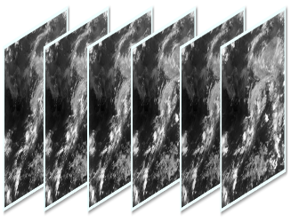
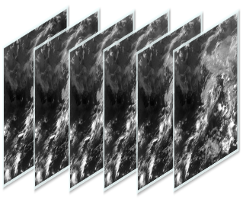
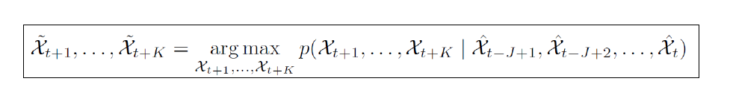
Time Series Sequence Forecast
Input sequence: Observed satellite images up to current time step.
Output sequence: Predicted satellite images for future time steps ahead.

Slide 7
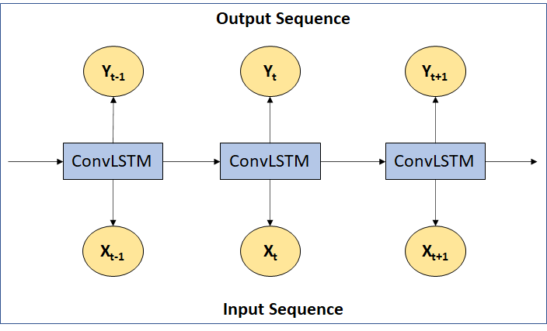
Sequence to Sequence Learning
Seq2Seq has showed better results in time series sequence forecasting
Satellite data contains Spatio-temporal patterns
To capture it effectively, a new extension to LSTM i.e. ConvLSTM would be suitable to build robust Encoding-Forecasting model for nowcasting.

Slide 8
Composite Model
V₄
V₅
V₆
Supervised
Learning
convLSTM
convLSTM
FORECASTER MODULE (Future Prediction)
Backpropagation
Copy states
V₄
V₅
ENCODER MODULE (State generation)
convLSTM
convLSTM
V₃
V₂
V₁
Copy states
V₁
V₂
V₃
DECODER MODULE (Input reconstruction)
Input Sequence
convLSTM
convLSTM
Unsupervised
Learning
Backpropagation
V₃
V₂

Slide 9
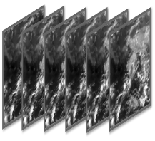
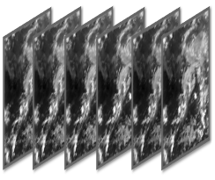
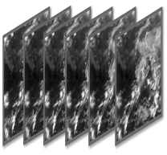
Composite Model (Cont’d)
**Forecasting LSTM module unfolds hidden state tensor to give the final prediction
**Forecasting Module
(Future prediction)
T[n+1,n+6]
ConvLSTM
ConvLSTM
ConvLSTM
ConvLSTM
*Encoding Module
(State generation)
ConvLSTM
ConvLSTM
T[n-5,n]
*The Encoding LSTM module compresses the whole input sequence into a hidden state tensor
***Decoding Module
(Input reconstruction)
T[n-5,n]
***Hidden state tensor representation is decoded through Decoder LSTM Module to predict input sequence in reversed order

Slide 10
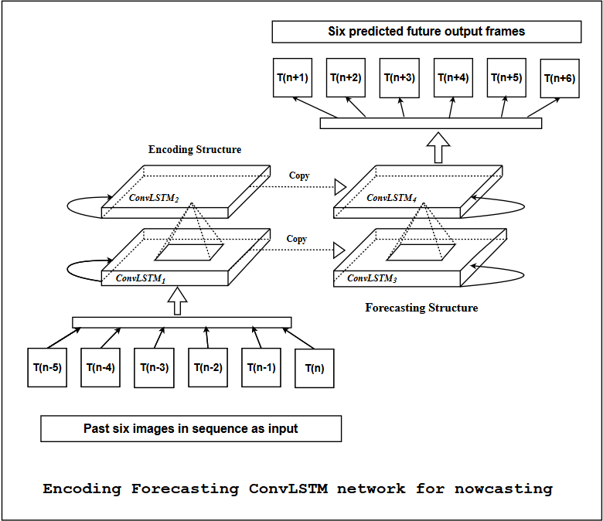
Encoding forecasting structure
Nowcasted data contains Spatio- temporal patterns and ConvLSTM which internally contains convolution operations has showed better results with fewer parameters.
As our problem is to nowcast, we will only combine encoding and forecasting module to predict future frame.
Encoding-Forecasting model will take 6 present images as input to predict 6 future images as output.
Mathematically it can be formulated as,
T[n-5 ,n] T[n+ 1 ,n+ 6]

Slide 11
Training and Data details
INSAT-3D and INSAT-3DR data was obtained in H5 format, 3rd June 2020 to 5th June 2020 from MOSDAC site
100 images are used to train the model, resulting 94 training sequences and Validated on 30 images
Each module of composite model consists of 2 layer of ConvLSTM having 16 filters and 3x3 kernel size
Sequences are normalised in feature range of [0,1]
Adam optimizer with learning rate of 10⁻³ has been used for training process and Binary cross entropy was used for loss conversion
Forecaster module has been trained using “Teacher forcing” method
1
2
3
4
5
6

Slide 12
Jury’s suggestion(Day 1 evaluation)
To validate on alternate data other than Testing so we chose 25th July 2020 and 18th May data
Calculate error plots between Ground truth and prediction
Return

Slide 13
Validation based on 6 performance metrics
Solution to 1st suggestion
Mean squared error (MSE)
Critical success index (CSI)
False alarm rate (FAR)
Probability of detection (POD)
Correlation
Accuracy
Link
The below table shows validation for INSAT 3D TIR channel on 25th July,2020
Threshold= 0.5
 | MSE | CSI | FAR | POD | Accuracy | Correlation
T(n+1) | 0.009601 | 0.715 | 0.240 | 0.932 | 0.889 | 0.936
T(n+2) | 0.015036 | 0.650 | 0.317 | 0.937 | 0.844 | 0.907
T(n+3) | 0.023130 | 0.547 | 0.440 | 0.962 | 0.748 | 0.876
T(n+4) | 0.016311 | 0.604 | 0.348 | 0.896 | 0.820 | 0.851
T(n+5) | 0.022832 | 0.554 | 0.413 | 0.915 | 0.771 | 0.824
T(n+6) | 0.024848 | 0.541 | 0.417 | 0.895 | 0.765 | 0.797
13

Slide 14
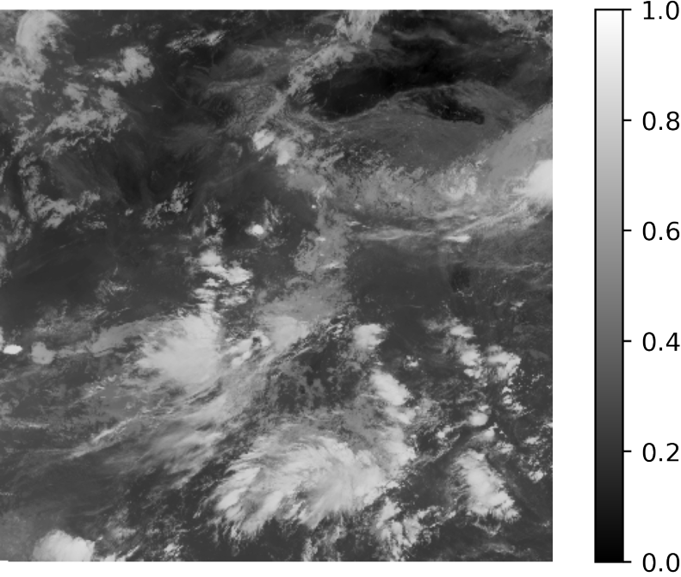
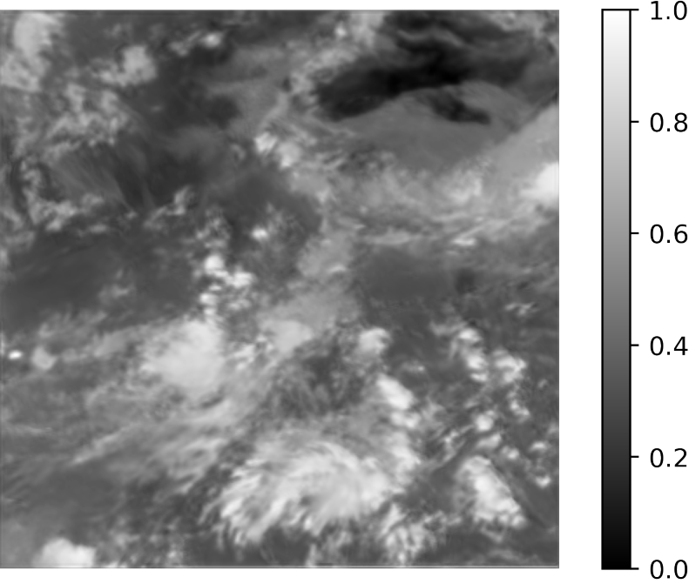
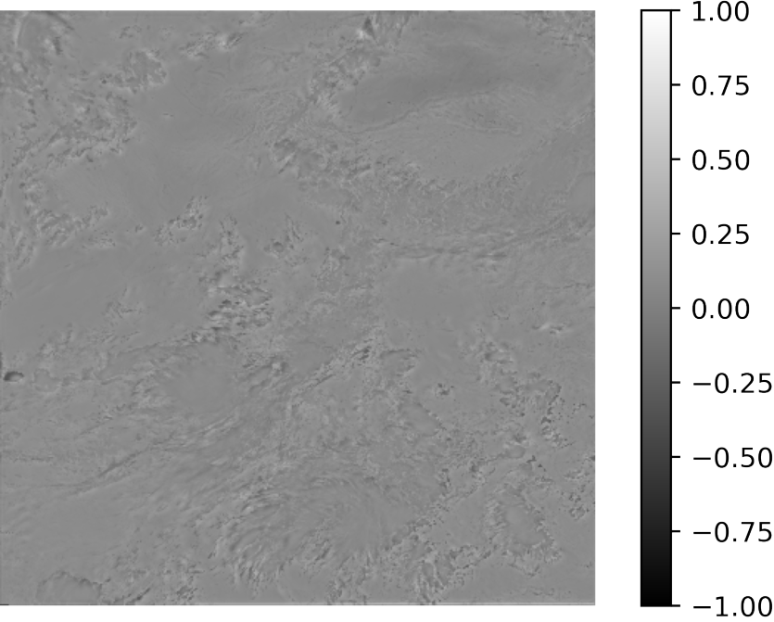
Solution to 2nd suggestion
Error calculation between Prediction and Label(Ground Truth)
Label data
Prediction
Error plot

Slide 15
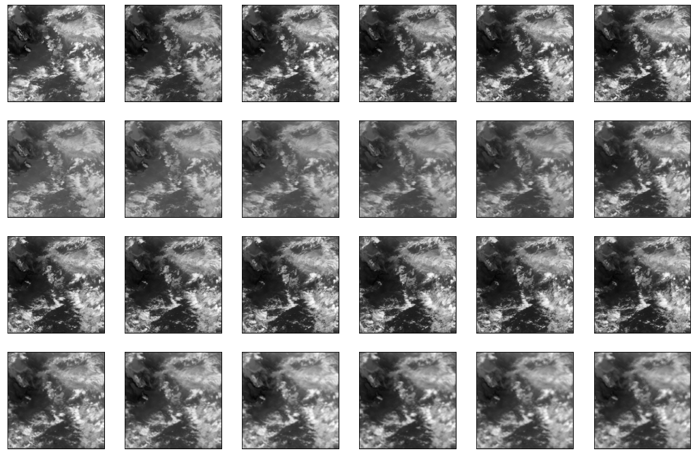
Results on interpolated full frame images(400 X 400)
Prediction examples for INSAT-3D TIR1 data
Input Sequence
T[n-5 ,n]
Decoder Output
T[n-5 ,n]
Output Sequence
T[n+ 1 ,n+ 6]
Predicted Frames
T[n+ 1 ,n+ 6]
T+30
T+60
T+90
T+120
T+150
T+180
t = 30 mins

Slide 16
Jury’s suggestion(Day 2 evaluation)
Calculate Auto-correlation for input data
Renormalize the data
To tackle the challenge with VIS channel data, suggestion for training only on daytime data was proposed.
Return

Slide 17
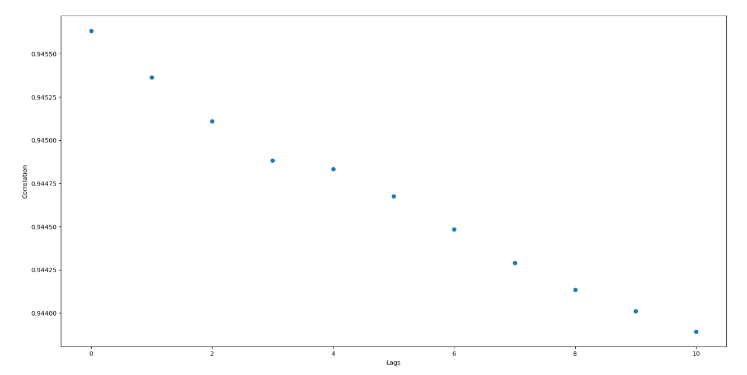
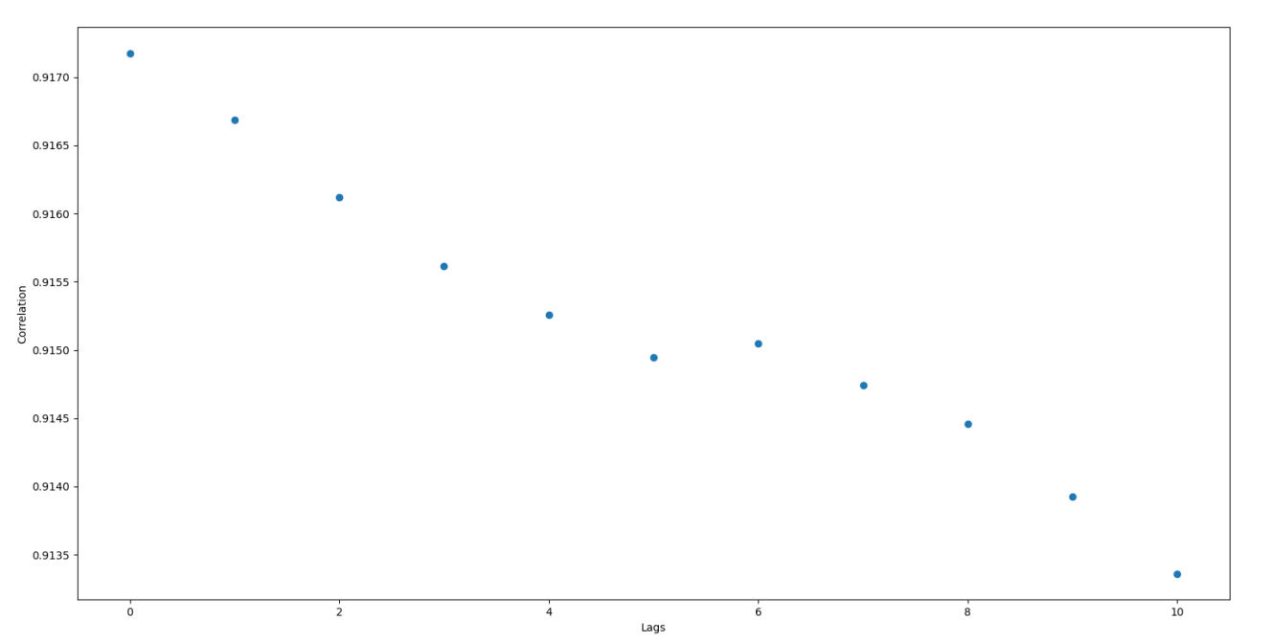
Solution to 1st suggestion
Auto-correlation
TIR Data Auto correlation
VIS Data Auto correlation

Slide 18
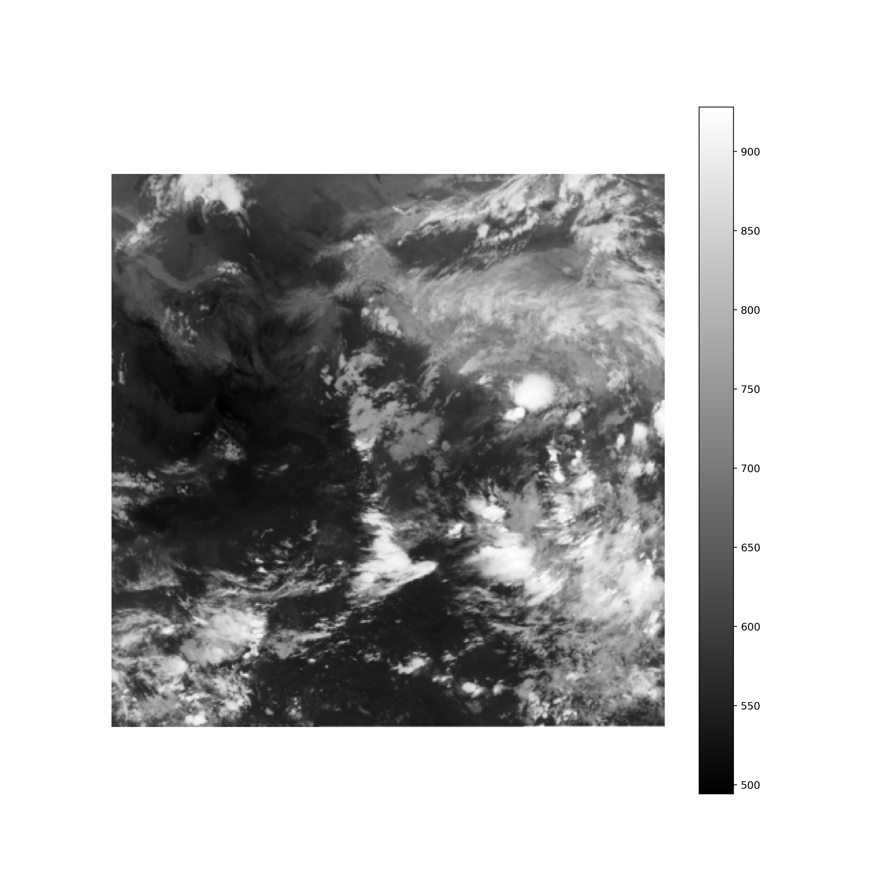

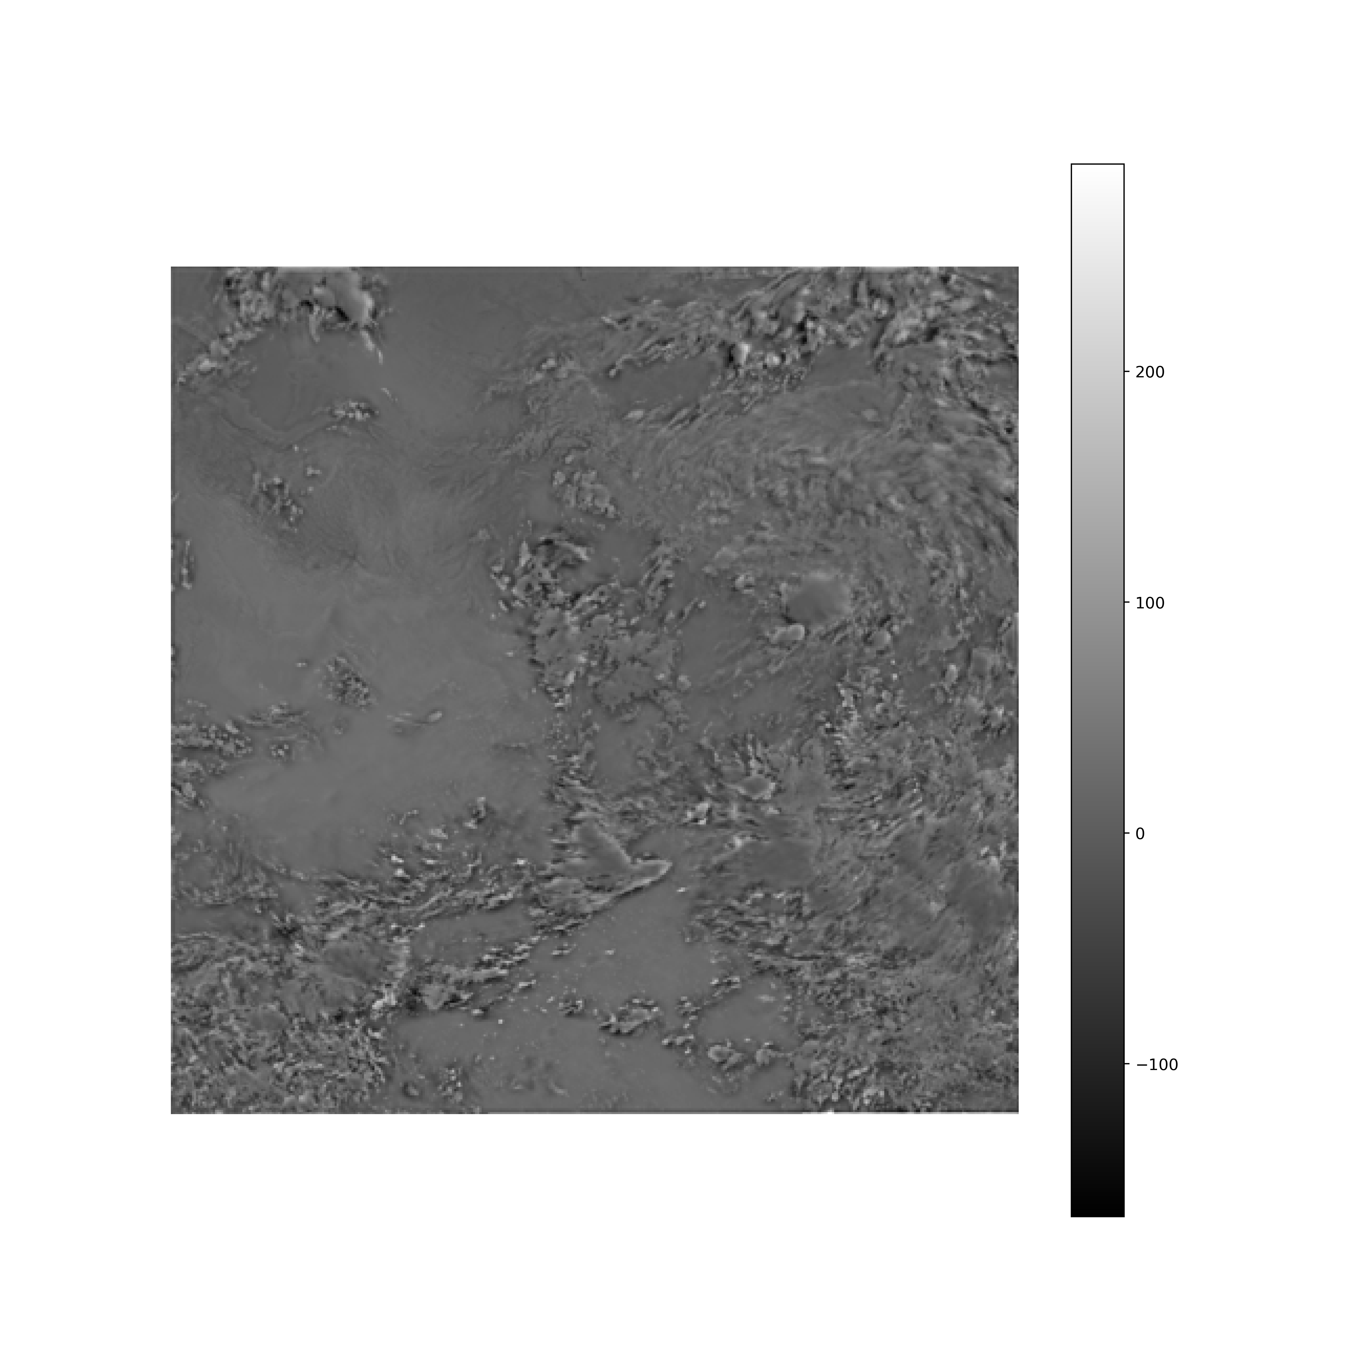
Solution to 2nd suggestion
Renormalized results for composite model
5th June 2020 – 18.00 IST
Ground Truth
Predictions
Difference

Slide 19
Jury’s suggestion(Final day mentoring session)
Prediction on a specific region[Size 404 X 404 of original image i.e(1616 X 1618)]
Correlation and MSE for the above predictions and its animation
Return

Slide 20
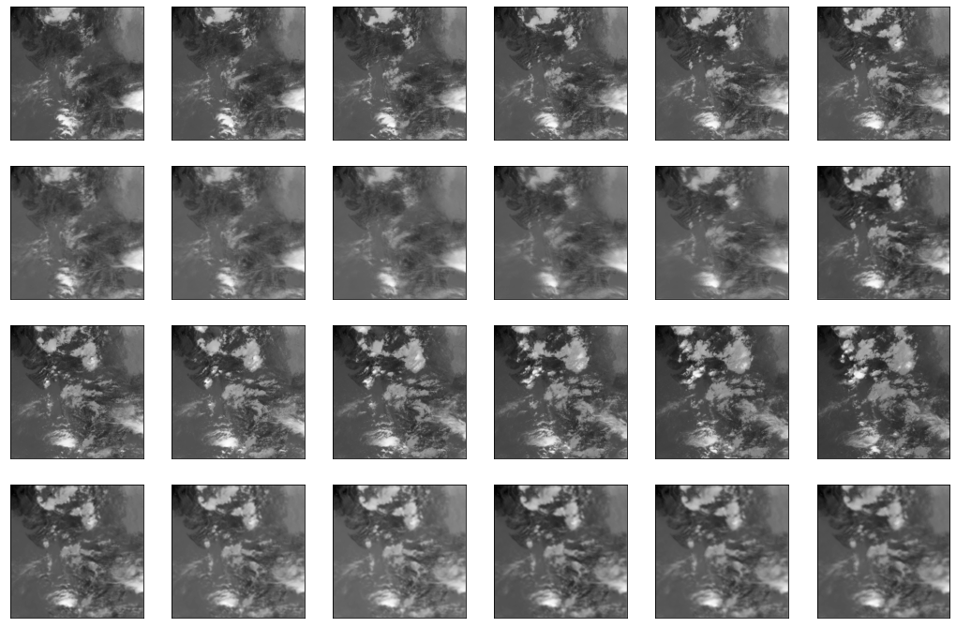
Solution to 1st suggestion
Prediction on a specific region[Size 404 X 404 of original image i.e(1616 X 1618)]
First predicted frame [TIR channel]
Input
Ground truth
Prediction

Slide 21
Prediction on a specific region[Size 404 X 404 of original image i.e(1616 X 1618)]
Input Sequence
T[n-5 ,n]
Decoder Output
T[n-5 ,n]
Output Sequence
T[n+ 1 ,n+ 6]
Predicted Frames
T[n+ 1 ,n+ 6]
T+30
T+60
T+90
T+120
T+150
T+180
t = 30 mins

Slide 22
Validation statistics for 404 X 404 region of original image(1616 X 1618)
Images | MSE | Correlation
T[n+1] | 0.00917 | 0.872
T[n+2] | 0.01704 | 0.773
T[n+3] | 0.02933 | 0.696
T[n+4] | 0.02521 | 0.632
T[n+5] | 0.03247 | 0.583
T[n+6] | 0.03453 | 0.540

Slide 23
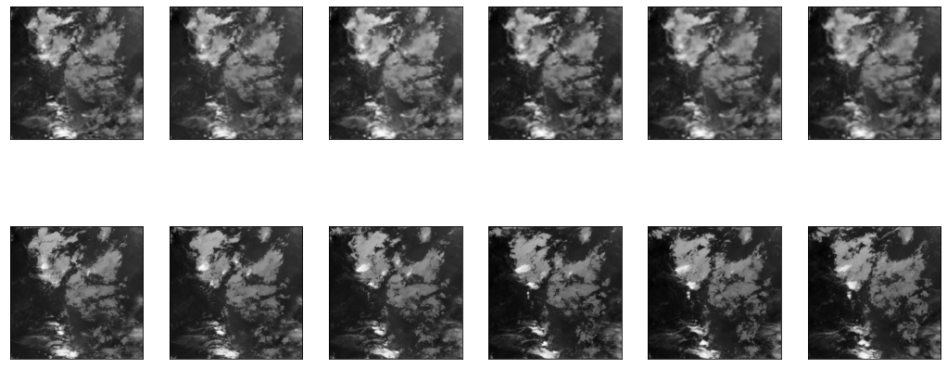
Prediction on a specific region[Size 128 X 128 of original image i.e (1616 X 1618)]
Output Sequence
T[n+ 1 ,n+ 6]
Predicted Frames
T[n+ 1 ,n+ 6]
T+30
T+60
T+90
T+120
T+150
T+180
t = 30 mins

Slide 24
Validation statistics for particular region of size 128 X 128
Images | MSE | Correlation
T[n+1] | 0.00691 | 0.825
T[n+2] | 0.01237 | 0.700
T[n+3] | 0.02389 | 0.609
T[n+4] | 0.01672 | 0.525
T[n+5] | 0.02425 | 0.454
T[n+6] | 0.02494 | 0.398

Slide 25
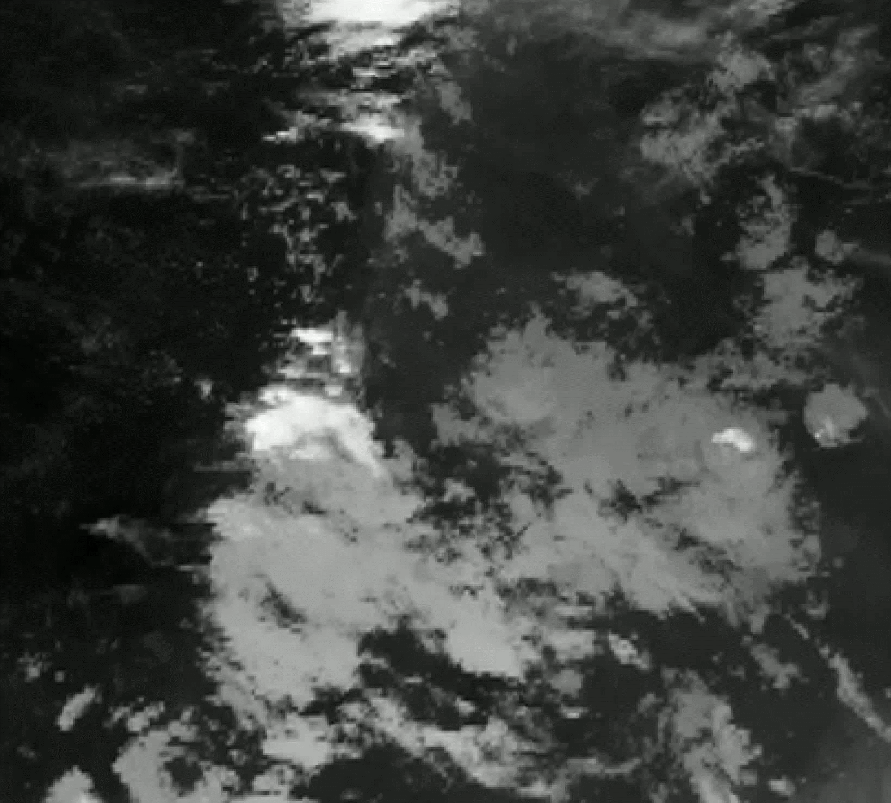
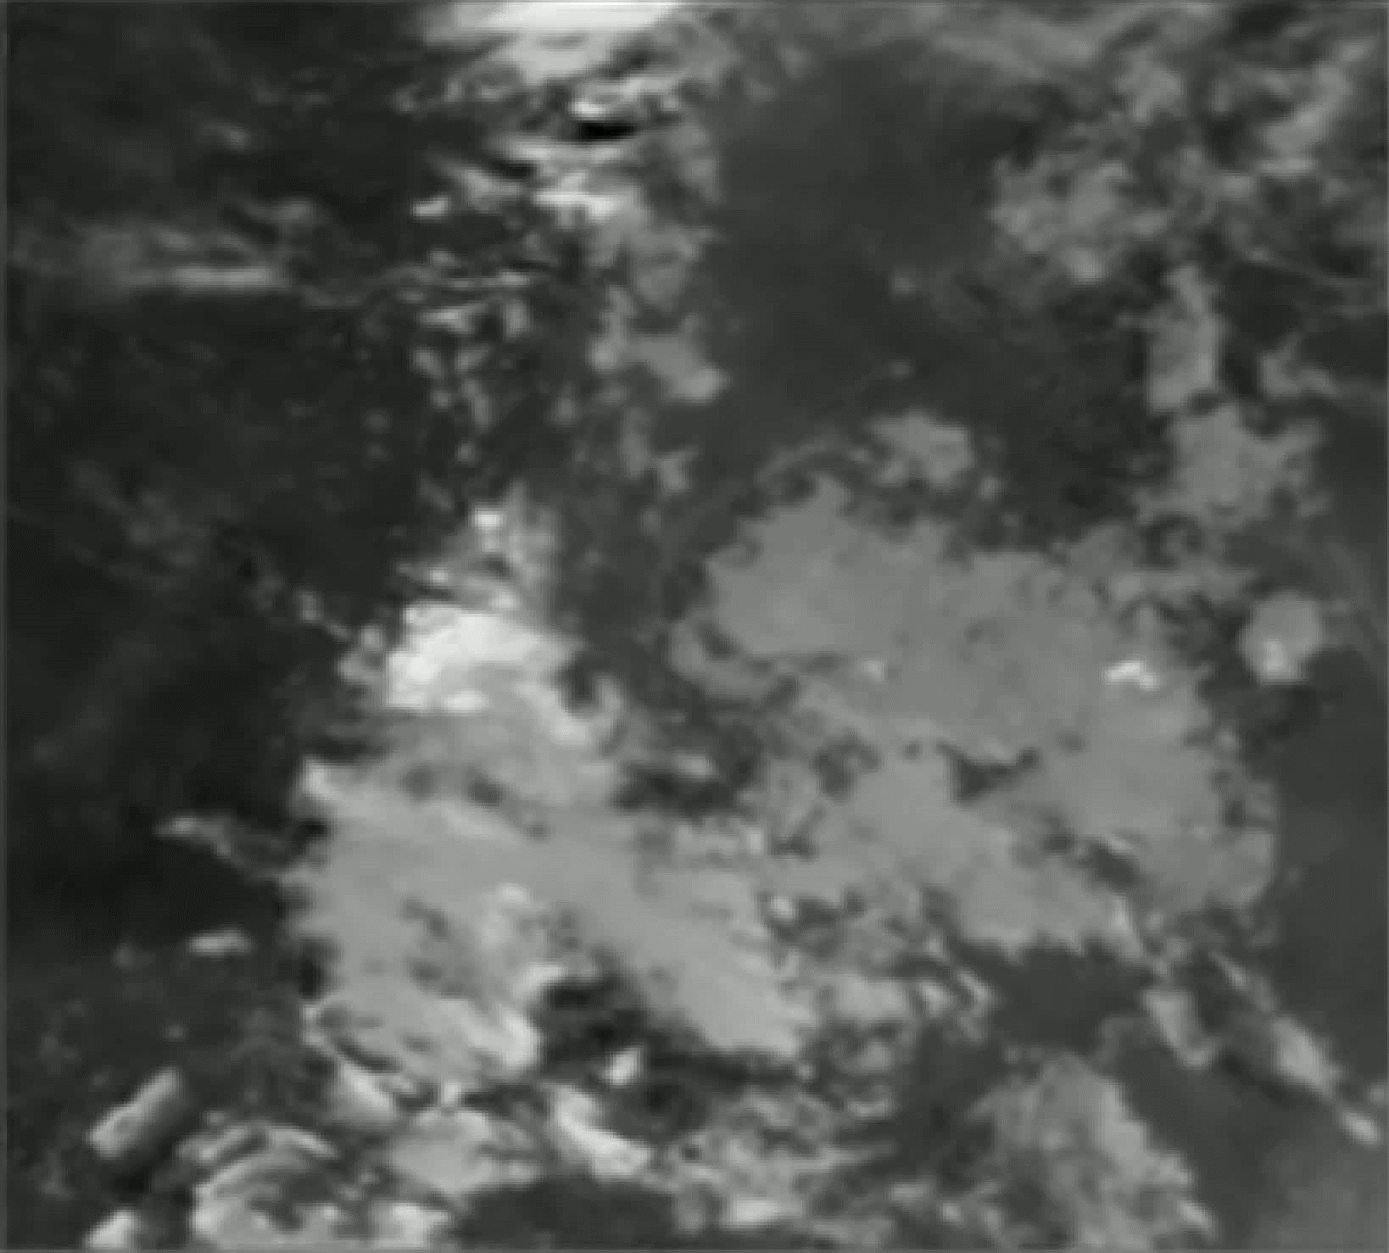
Animation for specific region prediction
Ground truth
Prediction

Slide 26
FUTURE WORK
OUR MODEL IS ADAPTED TO IN-CORPORATE CHANGES.
01 | Longer Training Dataset (~ more than 10 Years)
02 | Inclusion of Additional parameters to produce better Nowcasting Results.

Slide 27
References
1
Shukla, Bipasha & Kishtawal, Chandra & Pal, P.K.. (2014). Prediction of Satellite Image Sequence for Weather Nowcasting Using Cluster-Based Spatiotemporal Regression. Geoscience and Remote Sensing, IEEE Transactions on. 52. 4155-4160. 10.1109/TGRS.2013.2280094
N. Srivastava, E. Mansimov, and R. Salakhutdinov. Unsupervised learning of video representations using Lstms. InICML, 2015.
Kumar, Ashutosh & Islam, Tanvir & Sekimoto, Yoshihide & Mattmann, Chris & Wilson, Brian. (2020). Convcast: An embedded convolutional LSTM based architecture for precipitation nowcasting using satellite data. PLOS ONE. 15. e0230114. 10.1371/journal.pone.0230114.
Xingjian Shi, Zhourong Chen, Hao Wang, Dit Yan Yeung, Wai kin Wong, and Wang chun Woo. Convolutional LSTM network: A machine learning approach for precipitation nowcasting in twenty ninth conference on Neural Information Processing Systems(NIPS), 2015
2
3
4

Slide 28
Thank you.

